Slide 1
North Carolina Governor’s School 2022 (June 19- July 17, 2022) Millbrook HS
Mr. Flowers and Mrs. Levin
Notes:
Good afternoon and welcome to our Governor’s School interest meeting!

Slide 2
Outcomes of Today’s Session
Gain a brief understanding of Governor’s School:
eligibility
requirements
process
Know how to access to the Governor’s School Application
Notes:
After today’s session, you will have gained a better understanding of Governor’s School eligibility, requirements and process as well as know how to access the Governor’s School application.

Slide 3
Governor’s School Overview 2021
Notes:
Before we get started, let’s look at the video provided by the Governor’s School director that provides an overview of the 2021-2022 Governor’s School program!!

Slide 4
Notes:
The first thing you may want to know is, what is Governor’s School all about?

Slide 5
Governor’s School Overview
The Governor's School of North Carolina is a 4 week summer residential program
The curriculum focuses on the exploration of the most recent ideas and concepts in each discipline
Does not involve credit, tests, or grades
Notes:
What is Governor's School?
The Governor's School of North Carolina is a 4 week summer residential program for intellectually gifted high school students, integrating academic disciplines, the arts, and unique courses on each of two campuses
The curriculum focuses on the exploration of the most recent ideas and concepts in each discipline, and does not involve credit, tests, or grades

Slide 6
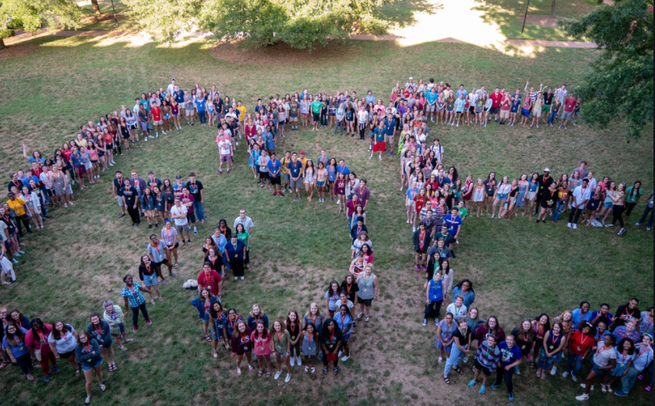
Governor’s School Overview
Oldest statewide summer residential program for gifted and talented high school students in the nation
Open to juniors only (exceptions made for sophomores in selected performing/visual arts areas)
Notes:
Governor’s School is the oldest statewide summer residential program for gifted and talented high school students in the nation. It’s mainly open to juniors, however there are exceptions made for sophomores in selected performing/visual arts areas which we will learn about later.

Slide 7
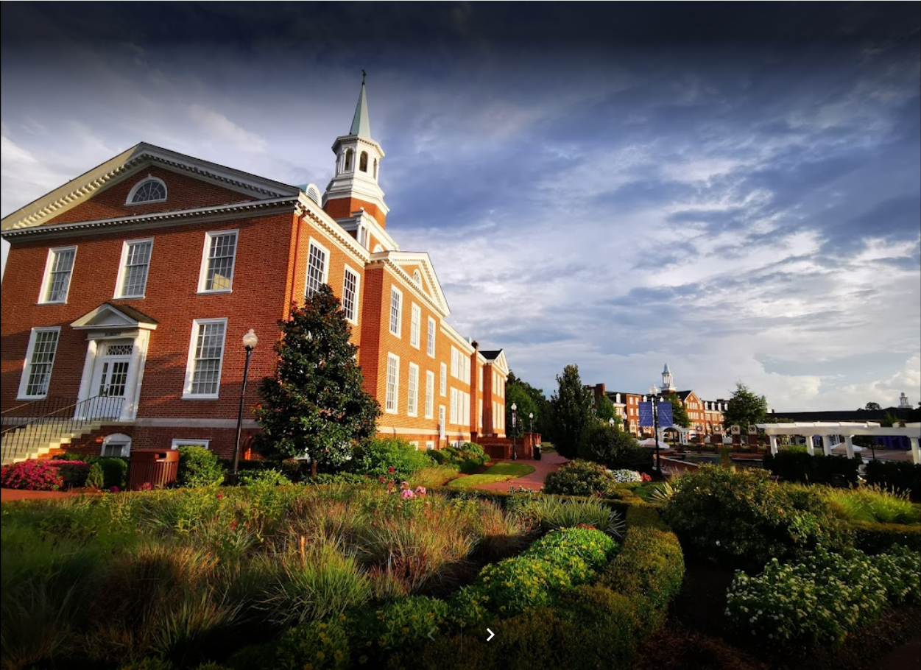
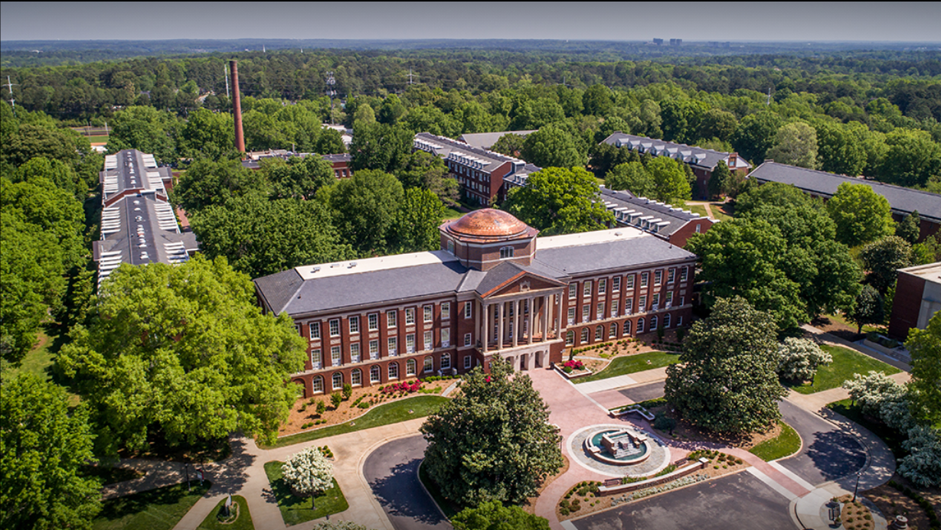
Governor’s School Overview
Governor’s School is held on two Campuses
Governor's School West at High Point University in High Point, NC
Governor's School East at Meredith College in Raleigh, NC
Notes:
Students who attend Governor's School will be housed at two campuses. Normally, Governor’s School West is at High Point University in High Point. We will know if this will still be the case in January of 2022. The site for Governor’s School East for the past 20 years, has been hosted by Meredith College in Raleigh. Students are assigned a campus, requests for specific campuses are not entertained. Students MUST commit to attending for the entire 4 weeks. Students cannot join late or exits early. Students may only return home for one weekend/mid-session break.

Slide 8
Governor’s School Overview
Governor’s School Housing
Students are assigned a campus, requests for specific campuses are not entertained.
Students MUST commit to attending for the entire 4 weeks. No late arrivals or early exits allowed.
Students may only return home for one weekend/mid-session break.
Notes:
Once your child has been selected to participate in Governor’s School, they will be assigned a campus. As explained earlier, the west campus is High Point University and the East Campus is at Meredith College. While staying on campus students must commit to attending for the entire 4 weeks. They cannot arrive late or come earlier than their scheduled time. Students may return home for one weekend/mid session break.

Slide 9
Governor’s School Disciplines
Students are nominated/selected in the disciplines listed below
Classes meet twice a day, Monday through Friday, and once on Saturday.
Discipline
Art | Natural Science
Choral Music | Social Science
Dance | Theater
English | World Language: Spanish
Instrumental Music | Mathematics

Slide 10
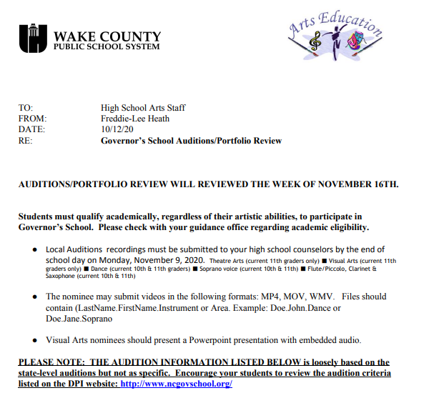
Governor’s School Disciplines: Arts
Auditions are for Performing/Visual Arts nominees only
We follow NCDPI guidelines for audition selections and requirements
WCPSS requires that Auditions be uploaded as a video of the nominees performance
Notes:
In addition to Area I classes (in the discipline in which a student is nominated), students also participate in Area II and Area III classes

Slide 11
Eligibility Requirements
North Carolina resident
Attend federal high school and are presently enrolled in 11th grade in North Carolina public schools or non-public schools
Exceptions for rising junior nominations are made in choral music, dance, and instrumental music
Exchange students or former Governor’s School students not eligible
Students nominated as sophomores, but do not attend may be re-nominated as junior
Notes:
Presently enrolled in 11th grade in North Carolina public schools (e.g., local school districts, charter, federal) or non-public schools (e.g., private, home schools, etc.)

Slide 12
Eligibility Requirements
Must meet achievement criterion established by Wake County Public School System:
Academic Nominee: 3.75 unweighted GPA
Arts Nominee: 3.5 unweighted GPA
Notes:
Weighted GPA criteria used only for eligibility purposes
Once met, weighted GPA criteria is not used in selection process

Slide 13
Governor’s School Nomination Form
Download the Nomination Packet
The WCPSS submission deadline is much earlier than the packet date, due to our district’s size.
Forms in the Packet must be completed electronically. To complete, download it from the site, save and print an individual form.
Notes:
Download the Nomination Packet for comprehensive information about the program, curriculum, timelines, eligibility and selection criteria, auditions, forms, tuition/scholarships, and more
The WCPSS submission deadline is much earlier than the packet date, due to our district’s size. WCPSS Central Service Academic and Art team reviews and selects our limited number of nominees to continue the process
Forms in the Packet must be completed electronically. To complete, download it from the site, save and print an individual form.
No handwritten applications will be accepted

Slide 14
What Should Be Turned into the Counselor?
http://www.ncgovschool.org
All forms can be found on the student services website
Student Application
Experience Form
Recommendation Form
High School Transcript
Notes:
all documents must be electronically uploaded
Student Application
Experience Form
Recommendation form
Recommendation Form (two per student)
Ask for recommendations early, and only from people who will give you a good reference
One recommendation from a teacher in your application area. (preferred)
The recommendations must be completed electronically and emailed to the GS Contact

Slide 15
Financial Responsibilities
All WCPSS students qualified and selected by DPI to participate will be able to attend
The total fee is $500.00. WCPSS will pay $250.00, so the student pays $250.00
Financial requirements for invited WCPSS will be sent with your acceptance information form

Slide 16
What Happens After Submission
1
Use Checklist to ensure accurate completion of application
2
Upload the applications
3
Applications are evaluated and results are shared
Incomplete or handwritten applications will not be accepted.

Slide 17
Important Dates
November 4, 2021
November 11, 2021
December 13
December 14-17
School Application Turn In Date to MHS
WCPSS Begins Application Review
Nominations due for state review
WCPSS mails students’ results

Slide 18
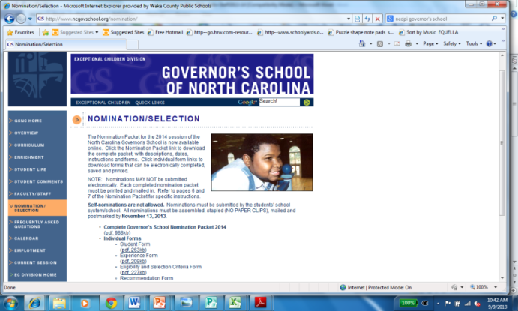
Questions?
NCDPI Governor’s School website: http://www.ncgovschool.org
https://millbrookstudentservices.weebly.com/gov-school.htmls
For questions regarding Arts and auditions see link on the MHS Gov. School webpage or your Arts teacher.

