Slide 1
Ancient china
1750 BCE – 170 CE

Slide 2
Geography
Archaeologists pinpoint two areas as the beginnings of Chinese civilization: the Yellow River and the Yangtze River. The area between these rivers emerged as one of the greatest food-producing areas of the ancient world.
The Xia (Syah) dynasty was founded over 4000 years ago in this area and was replaced by the Shang dynasty in about 1750 BCE.
Only 10% of China is suitable for farming, as most of the land is mountains and deserts. China is surrounded by mountains and oceans that keep the people of China isolated from other people. Like Egypt, this led to long periods of peace and prosperity.
There were areas in conflict, however – especially the northern border with Mongolia, where battles over land and territory occurred.

Slide 3
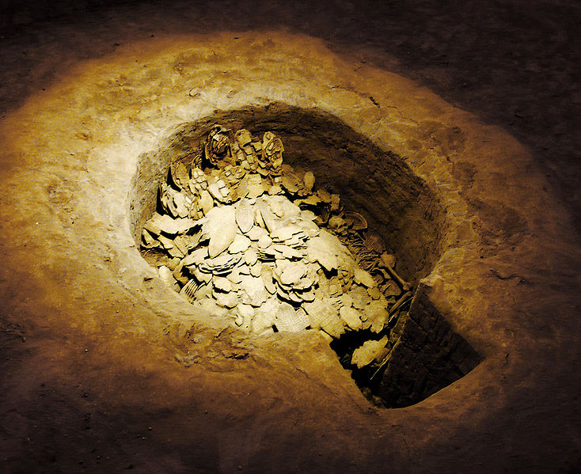
Shang Dynasty
The Shang Dynasty ruled from approximately 1750 BCE until 1122 BCE.
During the Shang Dynasty, farmers were ruled by the aristocracy (upper class) whose main concern was war. Power and wealth was passed down through families from one generation to another.
Archaeologists have found evidence the Shang Dynasty may have had as many as five different capital cities before settling on Anyang, just north of the Yellow River.
The Shang King ruled from Anyang. The country was divided into territories governed by aristocratic warlords who defended their territories. The king controlled large armies that defended the nation.

Slide 4
Shang dynasty – religion & culture
The early Chinese had a strong belief in life after death. They conducted human sacrifices in an effort to win the favor of the gods. Eventually this belief in the afterlife would develop into the veneration (worship) of ancestors.
The Shang had a mastery of bronze casting. With bronze they made pots, vases, urns, weapons, and other objects. Many bronze objects have been found in tombs under urban centers throughout Shang China.

Slide 5
Dynasty cycle in china
The Zhou Dynasty overthrew the Shang and set up their own dynasty in 1027 BCE.
The Zhou justified their takeover by claiming they had a Mandate of Heaven, or a divine right to rule. The Mandate of Heaven was used to explain the Dynastic Cycle. A dynasty would remain in power only as long as it was providing good government.
When a dynasty went into decline and abused its power, it was said to lose the Mandate of Heaven. A new leader would emerge and claim the Mandate and establish a new dynasty. Then the dynastic cycle would begin again.

Slide 6
Zhou Dynasty 1122 bce – 256 bce
The Zhou dynasty was the longest-lasting in Chinese history. The Zhou rulers continued the political system of the Shang dynasty, with a king at the top and a government bureaucracy to help the king rule.
Kings who got their power through the Mandate of Heaven were expected to rule according to the proper “way”, called the Dao. It was the king’s duty to keep the gods pleased in order to protect the people.
The idea of the Dao in ruling meant that the Chinese had the right to revolt any king
who was corrupt or abused his power.
The Zhou Dynasty declined when the city-states became stronger and challenged the ruler with civil war. The rulers had declined morally and intellectually, and in 403 BCE civil war broke out, beginning a period known as “The Period of the Warring States”. In 221 BCE, the Qin (Chin) took control of China and created a new dynasty.

Slide 7
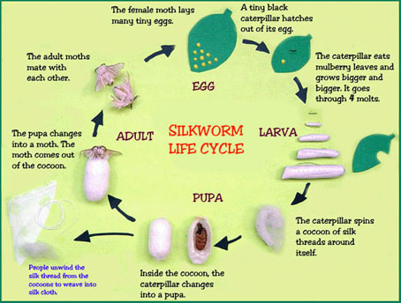
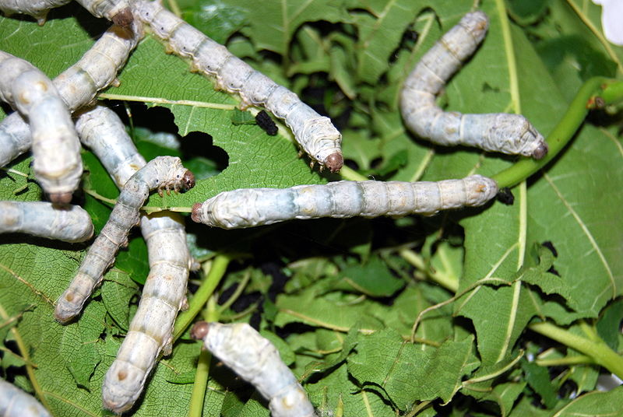
Life in the zhou dynasty
Under the Zhou, the Chinese discovered how to make silk from the cocoons of silkworms. Silk would become China’s most valuable export, eventually linking them with most of the world through trade. Chinese artisans also excelled in book making. The first books were made by binding together long, thin strips of wood or bamboo. Chinese scholars would then carefully paint characters on with brush and ink. The earliest book, Book of Songs, which includes a poetry describing a variety of Chinese life.

Slide 8
Life in the zhou dynasty
Economic & Technological Growth
6th-3rd centuries BCE were a time of growth. Irrigation controlled water, iron plowshares increased food, Silk was traded.
The Chinese Written Language
Chinese is a primarily pictographic language, which means picture symbols are used to represent an idea. When 2 or more pictographs are used to represent an idea it is called ideographic writing. Most other languages started using symbols that represented phonetics, or letter sounds. China has never completely abandoned using pictures in their writing.
Life during the Zhou Dynasty
The Aristocracy owned the land and the peasants worked land owned by the lord. Towns had merchants who were ‘owned’ by the lord like slaves. The Chinese traded along the Silk Road.
The Family in Ancient China
The family was the basic economic and social unit. Filial Piety: son or daughter gives up personal needs to serve male family head. Farming required the entire family, and sons inherited from their fathers. Men were the head of the family.. Women were subordinates, but in the royal family had some influence.

Slide 9
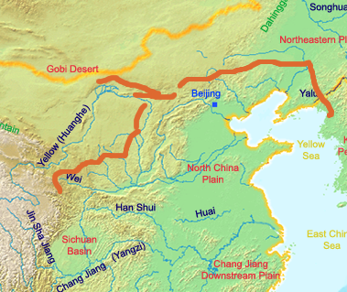
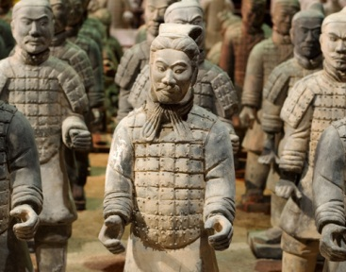
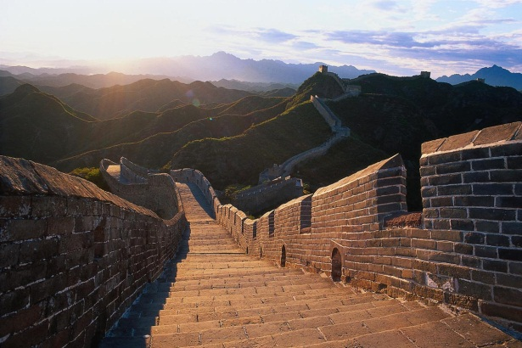
Chinese empires: qin dynasty 221 bce – 170 ce
Qin Dynasty: 221-206 BCE
Legalism was adopted by the Qin leaders.
The government was centralized with three key parts:
Civil Bureaucracy
Military
Censorate (Inspectors who kept tabs on the civil workers)
China was divided into provinces and counties. Members of the Civil Bureaucracy were appointed, with censors watching the civil servants.
Qin had a strong foreign policy and extended the Chinese border to the South
The Great Wall: the Xiongnu began invading from the north, near the Gobi Desert. Qin Shihuangdi (the Chinese ruler) began building the Great Wall to protect China. “The Wall of Ten Thousand Li” a li = 1/3 of a mile.
The Fall of the Qin Dynasty: After the first ruler, the dynasty was overthrown, followed by civil war.
One of the most unusual discoveries from the Qin period is the Terra-cotta Army. Archaeologists believe the army was created to accompany the Qin emperor in death.

Slide 10
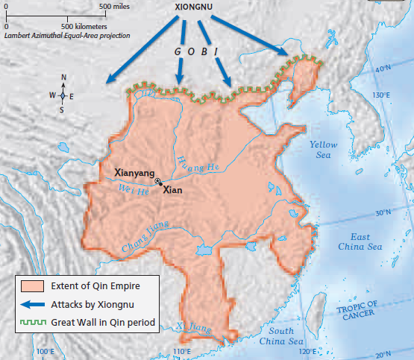
Map of the Qin Dynasty

Slide 11
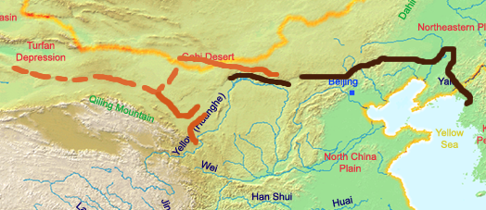
Chinese empires: the han dynasty 202 bce – 220 ce
Expansion of the Empire: Stretched to northern Vietnam
Political Structure: The Han dynasty got rid of Legalism and harsh political policies, but kept division of central government into 3 ministries: military, civil and censorate. During the Han Dynasty, Civil servants had to pass an exam to work for the government.
Society in the Han Empire:
The Han dynasty was a time of prosperity throughout China. There was one group, however, who suffered: free peasants. Their taxes were low, but they were expected to provide military service and forced labor up to one month a year.
The expansion of the population caused a reduction in the amount of land owned by free peasants – they did not have enough land to provide their families with food and were often forced to sell their land to wealthy nobles, making them tenant farmers on the land.

Slide 12
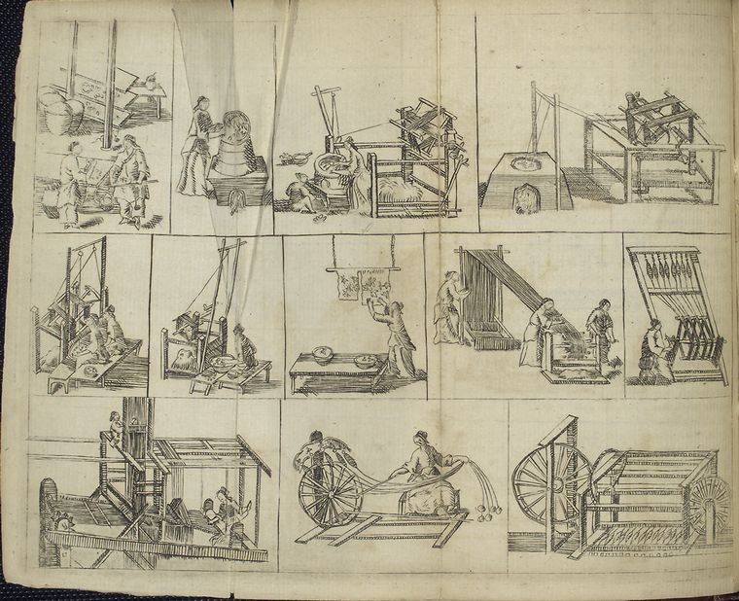
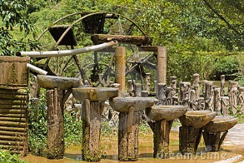
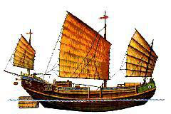
Han dynasty
Technology:
New technologies helped the Han dynasty prosper. The Chinese developed textile manufacturing (making cloth), water mills, and ship rudders and aft rigging, making it easier to sail and trade. Trade expanded and China increased its wealth.
The most notable technology was the invention of paper during the Han dynasty.
Silk Manufacturing
Water mills were used for grinding grain and casting iron
Ship rudders (at bottom left) helped steer ships.

Slide 13
Map of the han dynasty

Slide 14
Fall of the han dynasty – 220 ce
The Han empire declined over a long period of time. Their rulers became corrupt and worried more about their royal court than the Chinese people. The landed aristocracy – noble families – began to replace the central government as the force of power in China. By 170 CE, wars and uprisings brought about the collapse of the Han dynasty. In 190, rebels sacked the Han capital. China was again plunged into civil war and the next great dynasty would not arise for 400 years.

Slide 15
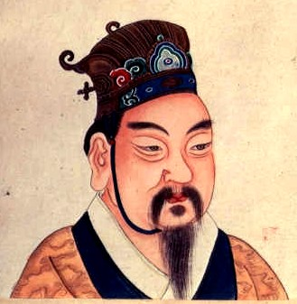
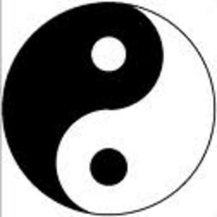
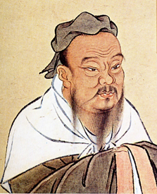
Philosophy/religion in early china
Confucianism
Confucius was a real man that wanted to be a political advisor. He is called “Master Kung,” the first teacher. His thoughts were recorded in the Analects. His interest in philosophy was political and ethical, but not spiritual. He felt that a person should behave in the way of the ‘Dao’. He believed government should be run by superior men.
Important Concepts:
Duty: all people had to set aside their needs for the family/society. Work hard and improve life on Earth.
Humanity: Compassion and empathy for others: “measure the feelings of others by ones own”.
Daoism
Based on the teachings of Laozi the Old Master, who lived at the same time as Confucius. The Way of the Dao are the writings of Daoism. Daoism does not care about the concerns of the Universe (where we come from), but looks at how we should act while we are here. To follow the will of Heaven is to do nothing. People should act spontaneously and let nature take its course.
Legalism
Unlike Confucianism of Dao, this philosophy professed that humans were evil and we could only be on the correct path if given harsh laws with harsh punishments. This was a system of impersonal laws. Rulers needed to create order because people were not capable of being good. A fear of punishment would cause people to serve the ruler.
Simply put, it seems that Confucius was more interested in how to get what one wants out of life, and how to behave in society. In contrast to Confucius, Lao Tzu (Laozi) was more interested in being in harmony with the world around him.
Yang Shang, founder of legalism

