Slide 1
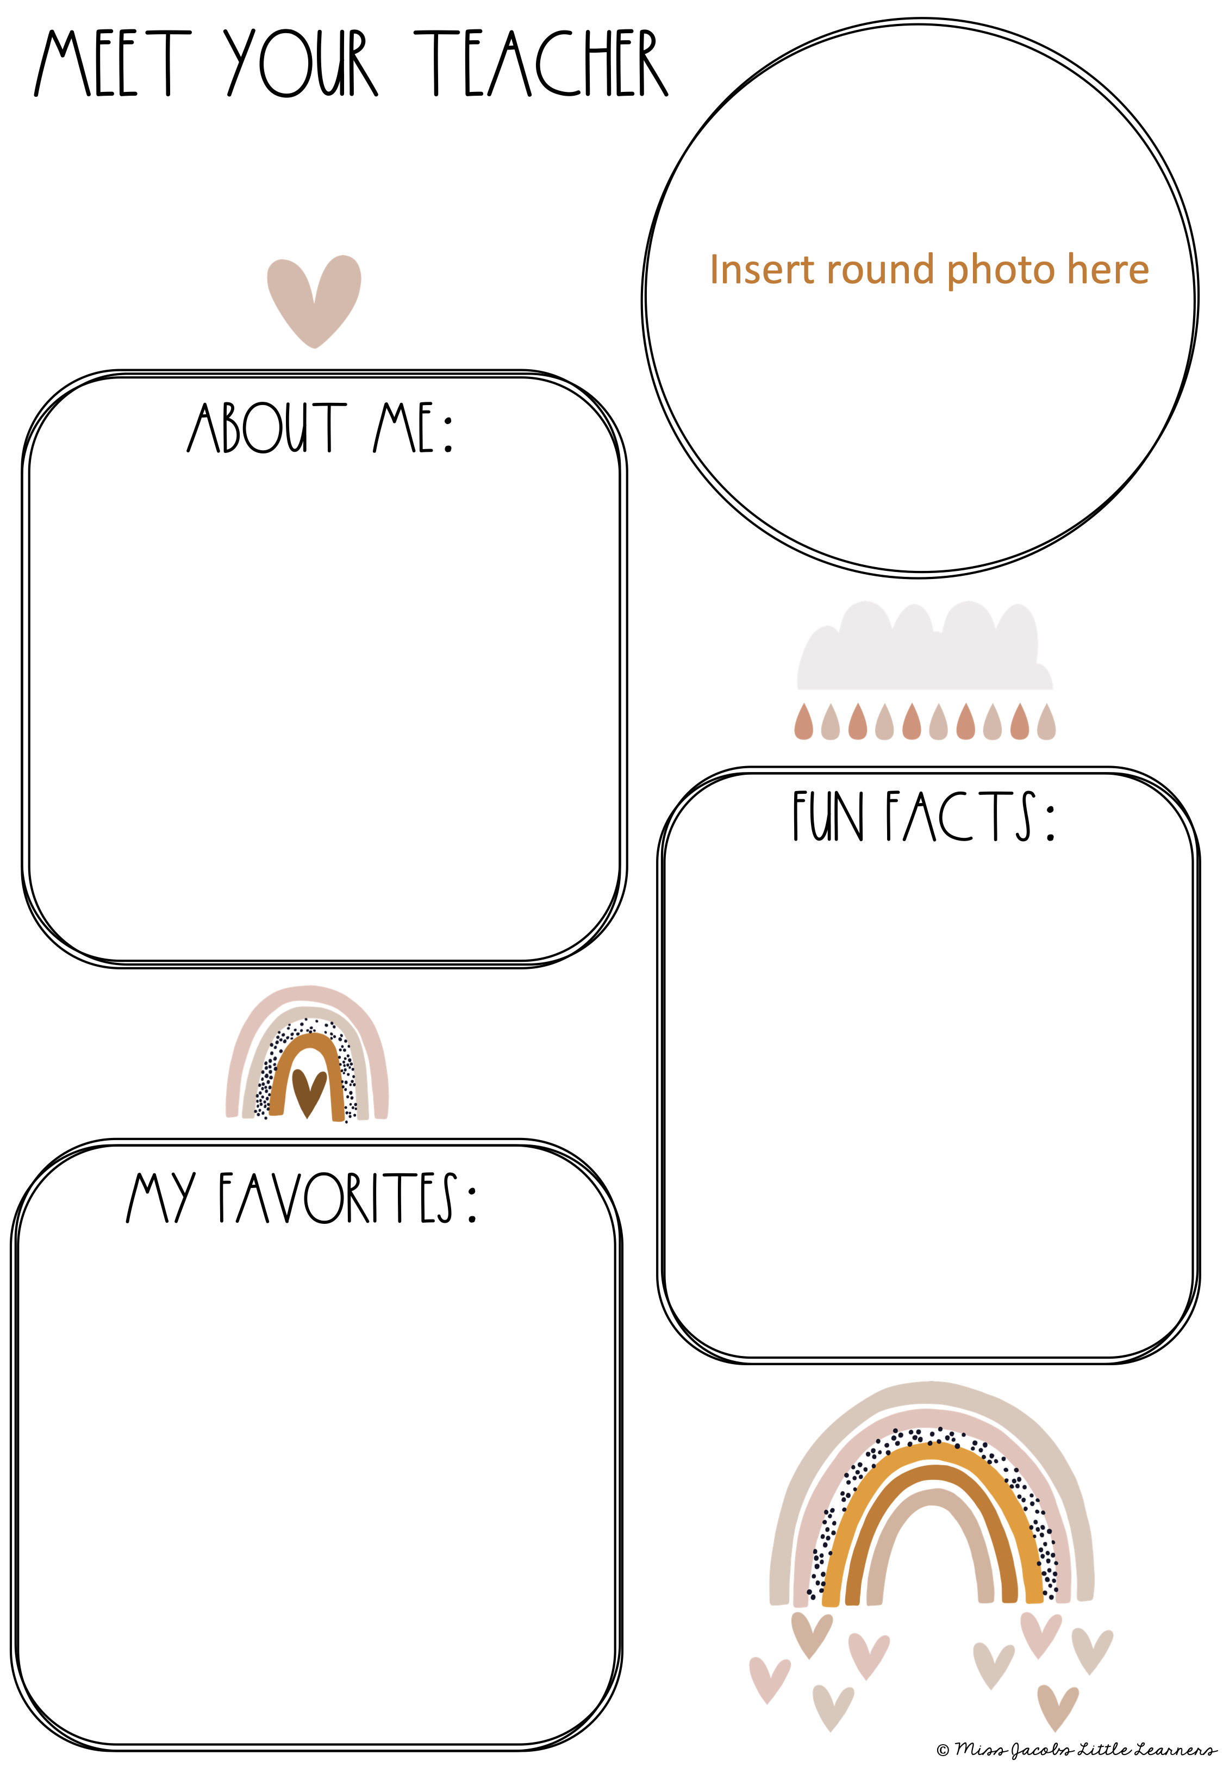
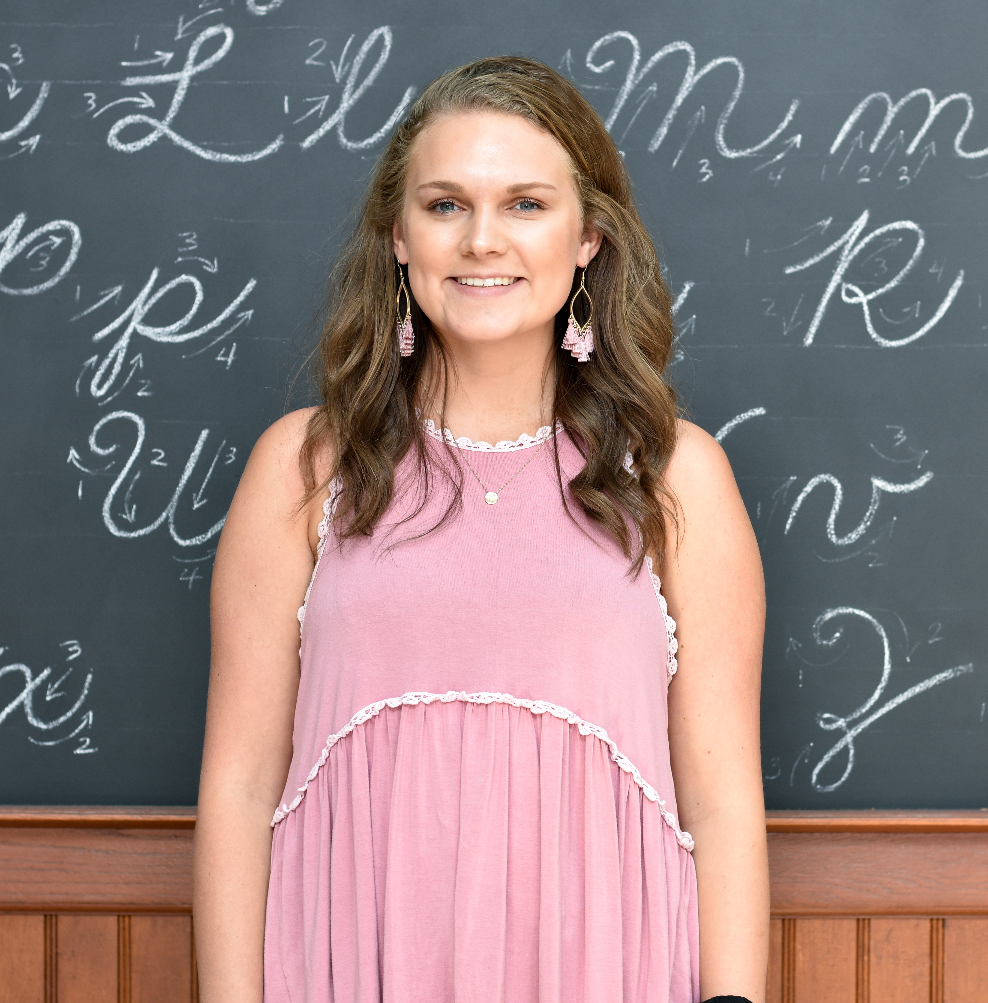
Ms. Anderson
Welcome to Kindergarten!
This is my 2nd year teaching kindergarten and I am new to Brassfield! I couldn’t be more excited! I graduated from UNCW in May 2021 with a degree in Elementary Education. I just moved to Raleigh, NC to be closer to my family!
It has always been my dream to become a teacher!
I have a cat named Phoebe
I like to travel
I cannot wait to get to know my students and their families!
Food: Tacos, Pasta, Chick-fil-A
Color: Pink
Store: Target
Drink: Hint Water
Candy: Reese’s
Sweet: Chocolate Chip Cookie
Season: Fall

