Slide 1
YES Coffee & Conversations Virtual Chat
WELCOME!
*Don’t forget to mute your microphone!

Slide 2
HELLO!
Meet York’s Admin Team
YES Admin Team
Tim Huber, Assistant Principal
thuber@wcpss.net
Kate Williams, Principal
kwilliams3@wcpss.net

Slide 3
Virtual Chat Reminders
Rated PG - language, comments
Mute your mics, we will have open Q & A at the end
Use the chat feature, we will monitor during the presentation and capture all questions for a YES FAQ document to post on our website.

Slide 4
State Requirements for Each Public School Unit
Department of Health and Human Services (NCDHHS)
Strong Schools NC Public Health Toolkit
Department of Public Instruction (NCDPI)
Lighting Our Way Forward: North Carolina’s Guidebook for Reopening Public Schools
Additional Requirements as designated by Executive Orders issued by Governor’s Office, NCDHHS, North Carolina General Statutes, and North Carolina State Board of Education Policy
REOPENING PLAN A Minimal Social Distancing | REOPENING PLAN B Moderate Social Distancing | REOPENING PLAN C Remote Learning

Slide 5
District Framework for Plans A, B, and C
COVID-19 REOPENING PLANS | Teaching and Learning | Social Emotional Wellness | Calendar | Health Precautions | School Facilities and Students | Transportation
REOPENING PLAN A Minimal Social Distancing | Traditional with preparation for Blended Learning WCPSS Virtual Academy | Back to school transition activities for all students (in all plans) Building and establishing relationships (in all plans) Teaching and supporting behavior expectations (in all plans) In-person and virtual mental health resources | All schools follow approved 2020 - 2021 school calendars | Enhanced health protocols Social distancing recommended Follow local, state, federal guidance | Open All students in school at same time | Traditional yellow bus and contracted transportation services
REOPENING PLAN B Moderate Social Distancing | Three Week Rotation: students are assigned to groups 1, 2, 3); attend school in an ongoing rotation - in-person for one week/online instruction for two weeks WCPSS Virtual Academy | In-person and virtual mental health resources | Traditional, Modified & Early Colleges follow approved 2020 - 2021 school calendars Multi-track Year Round & Single Track Year Round follow the Single Track 4 calendar | Enhanced health protocols in addition to increased requirements Social distancing required Follow local, state, federal guidance | Open One third of students in school facilities Two thirds of students remote | 23 students per bus run 1 student per seat 2 passengers per contracted vehicle
REOPENING PLAN C Remote Learning | Remote Instruction for all WCPSS Virtual Academy | Virtual mental health resources | Same as Plan B | N/A All at home | Closed No students in school facilities | N/A Support Food Service Delivery
Notes:
Difference Between Plan A and Plan B
Plan A - Social distancing is a RECOMMENDATION under DHHS guidance
Plan B - Social distancing is a REQUIREMENT under DHHS guidance
Since we know that not all students and staff can wear face coverings, we believe social distancing is one of the most important tools we have to prevent the spread of COVID-19 and minimize risk for students and staff.
In Plan B, students will be assigned to groups (A, B, or C). Siblings will be in the same groups. Groups will attend school in an ongoing rotation by attending school in person for one week and receiving online instruction for two weeks. Pre-K students will attend school daily.

Slide 6
LET’S TALK ABOUT...
PLAN B FIRST

Slide 7
PLAN B Scheduling
One of 3 plans (A-B-C)
1 week in school + 2 weeks out of school.
During 2 weeks out of school, students will be doing Remote Learning at home.
Student groups will be clustered by Central Office. Priority: siblings/transportation.

Slide 8
Returning to Campus under Plan B
Factors considered in our decision:
Emphasizes the health and safety of families and staff
Supports in-person learning
Provides schools and families information needed for planning
Provides a consistent schedule of in-person and remote instruction
Allows for strong instructional practices
Offers the most flexibility should conditions demand future changes to school schedules
Preschool and CCK will follow the Plan B as well
Please review the WCPSS Return to School Guidebook regarding procedures
Notes:
Yes, we support what the Governor has stated about the importance of in person learning
BECAUSE OF ALL OF THIS IT IS OUR RECOMMENDATION TO OPEN UNDER PLAN B FOR TRADITIONAL SCHOOLS ON AUGUST 17
Unapologetic attention to and commitment to the health and welfare of our people---students, teachers, staff, employees. As such, we examined the option that would most support this commitment.
Notice and consistent pattern for making childcare decisions

Slide 9
Structures

Slide 10
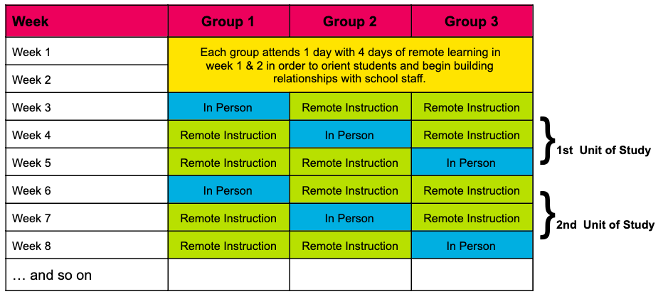
Scheduling of Instructional Time
Blended Instruction with Rotation by Week
Students attend schools in three groups with a rotation by week of attending school in person and receiving online instruction.
Example:
How do we put the structure into action?
Orientation in Week 1 & 2
Options for how to support principals and teachers with balancing teacher workload
Assignment of students to groups

Slide 11
Scheduling of Instructional Time
Structure & Logistics
Grading structures will follow Board Policy 3400, “Evaluation of Student Progress”.
There will be attendance expectations in both in person instruction at the school building and in online learning.
The pace of learning will be such the approved content goals and standards for the course or grade level can be implemented.
Learning Management Systems (ex - Canvas, Google Classroom) will have more consistency and alignment.

Slide 12
Scheduling of Instructional Time
Instructional Features
Rigorous core instruction delivered in person and remotely.
Smaller groupings of students to allow for greater personalized instruction, response to learning needs, supports, etc.
Opportunities for formal and informal assessments to guide work during online instruction.
Blended model provides multiple means of feedback to support student progress.
Structure to provide and collect instructional materials.
Prioritizing Health & Well-Being
Social distancing guidelines can be met.
Fewer students in the school setting at one time with time between attendance.
Ongoing focus on building relationships and supporting students’ social emotional health & well-being.
In class practice and teacher modeling of digital tools including safety expectations for online work.

Slide 13
Plan B Instructional Answers Based on FAQs
What does a typical day look like?
Students receive approximately 5-6 hours of instruction and/or instructional activities per day regardless of the learning environment.
Students will receive supports in AIG and Special Education services (combination of face to face and remote supports)
How are cohort groups being formed?
Group assignments will be first developed to place siblings who live in the same household in the same groups and organized by bus transportation patterns. After that, schools will complete the group assignments (1-2-3) with the remaining students assigned to their school. One of the factors schools will be considering is the academic needs of their students. Due to the complexity of developing group assignments, requests cannot be honored.
NOTE: Image shown to include what socially distancing students may look like only - not actual class size.

Slide 14
Live Instruction
Plan B
Virtual Academy
In Person: Full Day of In Person Instruction for one week
5-6 hours of instruction or instructional activities
This is a combination of direct teaching, collaborative, and independent learning
Remote Instruction for Two Weeks:
One hour per day live for a total of 5 hours per week with approximately four hours per day of non-live instructional activities.
A total of 5-6 hours of instruction or instructional activities with at least 2.5 hours of live teaching daily.
Virtual Academy Instruction:
At least 12.5 hours of live instruction per week.

Slide 15
Plan B Questions Continued
How will teachers balance Face to Face and Remote Learning?
Teachers will work collaboratively in Professional Learning Teams to design face to face and remote lessons for students.
A great deal of collaboration will be required in order to balance this task.
Instructional specialists and Instructional Assistants within the building will also be strategically utilized to help support classroom teachers in providing face to face and remote instruction.

Slide 16
Plan B Answers Based on FAQs
How will YES handle Lunch/Dismissal?
Some students will continue to bring lunch from home. Students electing a school lunch will have it delivered to students to the classroom by school staff. Social distancing procedures throughout the school day including afternoon dismissal.
What will Specials be like?
Work in progress, waiting for guidance.
What childcare will be available?
Before & After Care will be available. WCPSS is partnering with the YMCA for childcare as well. More information will be available next week.
How will guidelines impact visitors?
WCPSS has indicated only essential visitors will be allowed on school campuses in an effort to protect the health and safety of our community by minimizing the number of people on sites.
Notes:
Kayla
Recess guidelines are forthcoming

Slide 17
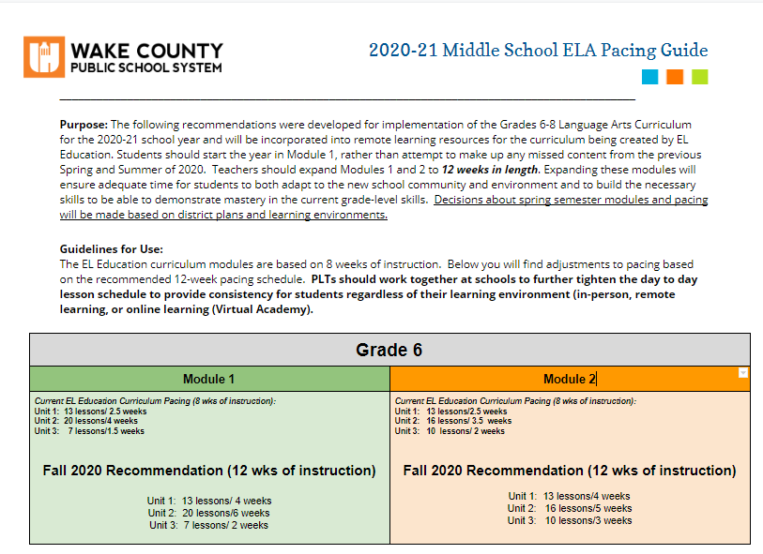
Curriculum
1
Pacing Guides and District Provided Curriculum Resources
Vertical Bridge Documents and Support
Blended/Remote Learning Lesson Plan Templates
Digital Resources Embedded Within Existing Curriculum
LEARNING OUTCOME/STANDARD
District Provided Curriculum
Plan B
In-Person
Plan B
Online
Virtual
Academy

Slide 18
Supports for Students with IEPs
Considerations:
Health and safety guidelines for vulnerable populations
Implementation of IEP goals for In Person Instruction Plan B, Online Instruction for Plan B, Plan C and WCPSS Virtual Academy:
IEP goal instruction, accommodations and modifications for students in General Content and Regional Programs
Alignment of content consistent across Plan B, C and Virtual Academy for students served in General content and Regional Program classrooms
(ULS for Extended Content)
Documentation of Services
Continuous challenge to implement
IDEA in online settings (FAPE)
District Provided Curriculum
Plan B
In-Person
Plan B
Online
Virtual
Academy

Slide 19
Notes
Staggered Arrival/Dismissal
Parent Pick-Up Requirements
Tailored curricular adjustments to support teachers, students, and parents
IEP support recommendations to support teachers, students, and parents
Adjusted schedules for elementary
K-12 Students Mask Requirements (DHHS/Governor/DPI)
Staff Mask Requirement
Classroom Capacity Study
Lunch (Classrooms)
Specials
Temperature Checks - AM

Slide 20
LET’S TALK ABOUT...
VIRTUAL ACADEMY
74 students signed up so far

Slide 21
WCPSS Virtual Academy
Core Goals of the WCPSS Virtual Academy
By establishing this fully online option, WCPSS will:
Provide access to an additional instructional option for students where health concerns exist with returning to the school building.
Provide a personalized, flexible learning environment that provides students with rigorous, standards aligned learning opportunities in an online setting.
Provide students with a certified teacher(s).
Virtual Academy is an option regardless of which plan Governor Cooper selects.
Notes:
Add to the talking points defining the word ‘personalized’. This should be in every environment. It is something we want to provide in a virtual environment.
Back in 2015, WCPSS defined personalized learning as a diverse variety of educational programs, learning experiences, instructional approaches, and academic-support strategies that are intended to address the distinct learning needs, interests, aspirations, or cultural backgrounds of individual students. (edglossary.org/personalized-learning/)
Notes: In the first bullet, we are addressing the needs of COVID-19. In the second bullet, we are acknowledging that opening a virtual academy (or something like it) has been a discussion in Wake for years. In the long-term, this gives us a platform to build out supports aligned to needs and potentially to provide greater access to acceleration.

Slide 22
WCPSS Virtual Academy: Application & Enrollment
Application:
Window to apply: July 10-20
Parents of students not currently enrolled in WCPSS will be directed to the Student Assignment website for enrollment procedures.
Once the application window closes, schools will send a district provided confirmation letter to families.
Enrollment:
Remain assigned to their current school.
Commit to at least a full semester of learning in this program, with a recommendation of a one year commitment.
K-12 students & families who participate in the Virtual Academy will be permitted to participate in co-curricular and extracurricular activities through their current school (Not planning any at this time at York).

Slide 23
WCPSS Virtual Academy: Schedules
To the degree possible, students will be assigned teachers from their current school. However, in some cases, students may be assigned to teachers from different schools within a region to form classes.
All K-8 core courses and all high school courses required for graduation will be offered. Because course offerings for the Virtual Academy will be built based on the course selections of students who enroll, it is difficult prior to the application window closing to identify what specific courses will be offered.
The intent will be to make every effort to ensure that there is a baseline menu of both core and elective course offerings across multiple content areas.

Slide 24
WCPSS Virtual Academy: Schedules
Students / families should expect instruction to happen Monday - Friday.
Students will receive approximately 5-6 hours of instruction and/or instructional activities per day regardless of the learning environment.
Virtual Academy: At least 2.5 hours of live instruction per day
Note: Time may increase beyond the baseline based on teacher planning.
Students will experience an intentional effort on the part of their school’s staff to make meaningful connections and to create a true classroom community.

Slide 25
Virtual Academy FAQs
How long am I enrolled?
Students who choose fully online instruction will remain in that setting through the fall semester. Students may return to their classroom setting in the spring semester, if space permits. The recommendation is that students enrolled in the WCPSS Virtual Academy remain for the entire school year.
How flexible is the schedule?
There will be synchronous and asynchronous learning opportunities. Students will have select times to log in to have live instruction and support from the teacher. Other times, students will have the flexibility to complete assignments when it works best for the family.
How will the teacher know if my child has mastered content in Virtual Academy?
Teachers will follow WCPSS Board Policy 3400.
Teachers may give pre-assessments that help determine what students already know and where they need support. This data will guide lesson planning. Whole class, small group, and individual instruction will be provided based on student needs. Post assessments will also be given to determine student mastery.
Notes:
Kiley

Slide 26
WCPSS Virtual Academy Communication
WCPSS Virtual Academy Website
SchoolMessenger (After Enrollment)
Social Media (WCPSS Twitter)
Virtual Academy Open House: Thursday, July 16, 2020 @ 5:30pm.
*If you missed it, it has been archived

Slide 27
Notes
Virtual Academy students will never have to report to the building
At least a semester commitment (January 15)
Curricular expectations will be the same
Lunch (Home/WCPSS options)
Specials
Counseling opportunities
2.5 Hour (BEST PRACTICE DIRECT, likely will be more)
Tailored curricular adjustments to support teachers, students, and parents
IEP support recommendations to support teachers, students, and parents
Adjusted schedules for elementary

Slide 28
WHAT HAPPENS IF NC CHANGES PLAN B TO PLAN A OR PLAN C?

Slide 29
Notes
Plan B students would move to Remote Learning at Home
Virtual Academy students will stay with their Virtual Academy teacher
If everyone moves to Plan A, Virtual Academy students will still have the option to remain in Virtual Academy. All other students would move to Plan A
A shift would be made on the academic calendar to support an even return (grading)

Slide 30
Let’s Review

Slide 31
Notes
Plan B students will use staggered entry for week of Aug. 17 and Aug 24 (1 day per week) based on cohort 1, 2, 3
Virtual Academy is 100% online
Virtual Academy teachers may also include teachers from other schools
Plan B & Virtual Academy will have the same curriculum and grading expectations
NC Requires 3 plans (A/B/C)
NC will operate on Plan B (Districts CAN still elect Option C for safety concerns)
Plan B for WCPSS = 1 week in-person + 2 weeks at-home, with Remote Learning
Rotation groups are not made by schools. The focus is on siblings & transportation.

Slide 32
Cleaning
Buildings will be thoroughly cleaned and disinfected throughout the day and every evening. Multiple times a day, our custodian will perform the following duties, among others:
> Sweeping, dust mopping, and spot mopping hallways, steps, and stair landings, as well as the cafeteria;
> Cleaning and disinfecting hall water fountains;
> Cleaning and disinfecting bathroom floors, sinks, toilets, urinals, and stall handles; monitoring hand sanitizer, soap, and paper products;
> Wiping and disinfecting touch points in halls, common areas, and classrooms, if accessible.
Our disinfectant is an EPA-approved disinfectant for SARS-CoV-2, the virus that causes COVID-19.
Current cleaning and disinfecting protocols will continue to be reviewed and enhanced in terms of frequency and intensity.

Slide 33
Health, Safety, Social Distancing FAQs
How will you handle health screenings?
A team of staff will be trained to handle health screenings every morning. This will become a morning duty for this team of employees. If a student plans to leave campus for any reason and return later in the school day, he or she should get a dated health screening pass before leaving the building so they will not have to go through the health screening again upon his or her return to school.
Who has to wear a mask?
All students riding a bus (unless there is a developmental, behavioral, medical, or religious exemption). This week, the Governor indicated that K-12 students should wear a mask unless there is an exemption. Staff and visitors must wear a mask unless there is an exemption.
Are there plans for mass testing by the school/district?
Not at this time.
Notes:
Students must be screened at home prior to coming in to school.

Slide 34
COVID-19 Students with Symptoms
Students who have experienced at least one COVID-19 symptom, with or without being diagnosed with COVID-19, should not be in school.
They should stay home until they (or a family member answering for a younger child) can answer YES to all three of the following questions:
> Has it been at least 10 days since they first had symptoms?
> Has it been at least 3 days since they had a fever (without using fever-reducing medicine)?
> Has it been at least 3 days since the symptoms have improved, including cough and shortness of breath? Students are not required to have documentation of a negative test in order to return to school. If students have a negative COVID-19 test, they can return to school once there is no fever without the use of fever-reducing medicines and they have felt well for 24 hours.
Notes:
These procedures are the same for employees

Slide 35
COVID-19 Students Diagnosed with No Symptoms
Students who have been diagnosed with COVID-19, but do not have
symptoms must remain out of school until 10 days have passed since the
date of their first positive COVID-19 diagnostic test.
>Students are not required to have documentation of a negative test in
order to return to school.
>If a student develops symptoms, they cannot return to school until they
meet all of the criteria for students who have experienced at least one
symptom.

Slide 36
COVID-19 Exposure
Students who have been exposed to COVID-19 and do not have symptoms must remain out of school for 14 days since their last exposure, even if they test negative for COVID-19. If they develop symptoms, they cannot return to school until they meet all of the criteria for students who have experienced at least one symptom.
> Has it been at least 10 days since they first had symptoms?
> Has it been at least 3 days since they had a fever (without using fever-reducing medicine)?
> Has it been at least 3 days since the symptoms have improved, including cough and shortness of breath?
Notes:
Kiley

Slide 37
COVID-19 on a School Campus
Procedure for Report of COVID-19 on Campus
We will report suspected, presumptive, or positive cases of COVID-19 to Wake County Public Health and work with them for follow-up and contact tracing.
If a person with COVID-19 was in a WCPSS facility while infectious, we will coordinate with local health officials to notify employees and families while maintaining confidentiality in accordance with FERPA, NCGS 130A-143, and all other state and federal laws.
In the event of a confirmed case of COVID-19 in a school, the affected areas will be closed for 24 hours, then systematically disinfected.

Slide 38
Technology Requirements
Students that checked out a Chromebook and/or Hotspot will continue to use the devices they checked out at this time.
The district is working on a plan to provide additional laptops and Hotspots to incoming families that request one.
Notes:
Students will use their personal device or the school device they used for remote learning last year for VA or remote learning for the 2020/2021 school year. If they are enrolled in the Plan B option, students should keep these devices at home when the students come to school for their one week in school. The school will have devices for students to use while in school. If you did not checkout a device and need one or a hotspot the district is working on a plan to provide these resources for the students.

Slide 39
Social Emotional Learning & Student Support Services
All students will have access to social and emotional support through meaningful connections and a classroom community.
The district is developing additional guidance and collaborating with community partners to ensure we are maximizing mental health resources for staff, students, and families.
All students will get appropriate support and services through the general education program, special education, Individualized Educational Plans (IEPs), 504 plans, Academically & Intellectually Gifted (AIG), English as a Second Language (ESL), and intervention.
All students will get support from their counselors, social workers, and school psychologists, as needed.
Notes:
Jordan

Slide 40
Where we are in the timeline?
July 20
Early Aug
Aug 14
Aug 17
Deadline for Virtual Academy Sign-Up/Enrollment. You DO NOT lose your seat in your physical school by signing up for VA.
Families receive information for cohort rotations (1, 2, 3) with Plan B.
Virtual York Meet the Teacher
More to come!
First Day of School (Remember only Plan B students will report on a specific day during this week). NOT A ROTATION WEEK.

Slide 41
When I’m asked what to do about school…
The WCPSS Virtual Academy will provide the consistency that some families and children need no matter which plan we are in throughout the school year.
If your child is highly adaptable to changing schedules and routines then Plan B is also a viable option.￼
Either way, your children will be exposed to the same curriculum no matter what option you choose.￼ You really just have to make the decision based on what gives you piece of mind and is best for your family. Any decision is the “right” decision. I can’t tell your family what will work best for you, but I do know, YES teachers, school staff, and administration will be working beyond hard on every level!

Slide 42
STAY
CONNECTED
Twitter
FaceBook
School Website
SchoolMessenger (Emails/Texts)

Slide 43
Q & A
Please use the chat to note if you have a question.
We will answer and may ask speakers to unmute if clarification is needed.

Slide 44
Thank You

