Slide 1
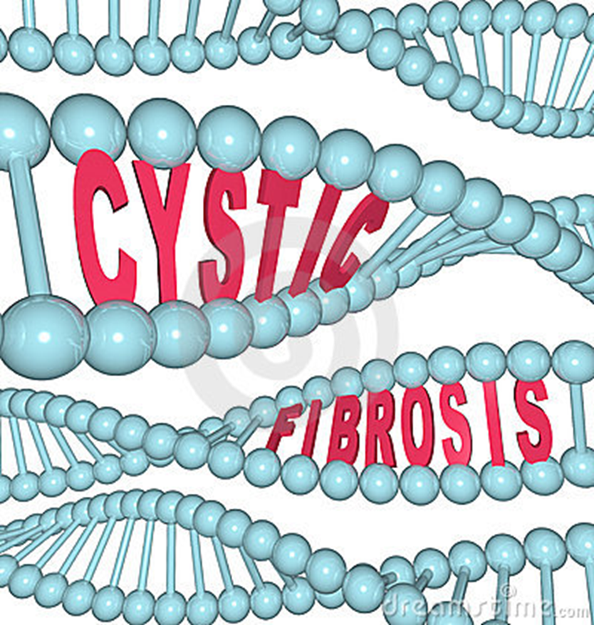
Cystic Fibrosis
By: Danielle Hirsch, Kaitlyn Price, Amber Wilkins, and Donovan Boyle
Other names for cystic fibrosis are CF, Pancreas fibrocystic disease, and Pancreatic cystic fibrosis. The name was chosen because cystic means biliary area and fibrosis refers to the scarring of the tissue. So Cystic Fibrosis means tissue scarring of the biliary area. The American Pathologist Dr. Dorothy Anderson provided the first description of the disorder. It was discovered in 1938, in the lungs. It was found by results of various tests.

Slide 2
Type of genetic disorder
Our disorder is cystic fibrosis. Cystic fibrosis is when it affects the exocrine glands. It causes the production of thick mucus, which leads to blockage in the intestines and many result to bronchi and also resulting to a respiratory infection.
The disorder is inherited by two copies of a defective cystic fibrosis gene. You only get these, one from each parent.
Notes:
Danielle

Slide 3
Chromosomes/genetics graphic
Notes:
Donavan

Slide 4
Symptoms of disorder
Cystic Fibrosis causes thick mucus in the lungs, it causes wheezing and Shortness of breath.
When your child gets older they start to get sinus infections, bronchitis, or pneumonia often. When you get cystic fibrosis you start to get growths, called polyps, in the nose. You start to get bulky, oily, or foul-smelling stool. You can also get too much gas, constipation, or stomach pains. Weight loss or failure to gain weight may start to happen. You will also have low bone density.
Notes:
amber

Slide 5
Effects of disorder
Cystic fibrosis makes a thick, buildup of mucus in the lungs, pancreas and other organs. When mucus gets stuck in the lungs, the mucus clogs the airways and traps bacteria leading to infections, extensive lung damage and eventually, respiratory failure. When mucus gets stuck in the pancreas, the mucus prevents the release of digestive enzymes that allow the body to break down food and absorb vital nutrients. Other effects may include wheezing, shortness of breath, salty-tasting skin, a lot of coughing, lung infections including pneumonia or bronchitis, poor growth or weight gain, and difficulty with bowel movements.
Notes:
Kaitlyn

Slide 6
Diagnosis of individual with disorder
Doctors diagnose cystic fibrosis based on the results from various tests.
Newborn Screening
All States screen newborns for cystic fibrosis using a genetic test or a blood test. The genetic test shows whether a newborn has faulty Cystic Fibrosis Transmembrane Regulator genes. The blood test shows whether a newborn's pancreas is working properly.
Sweat Test
If a genetic test or blood test suggests cystic fibrosis, a doctor will confirm the diagnosis using sweat test. This test is the most useful test for diagnosing cystic fibrosis. A sweat test measures the amount of salt in sweat. For this test, the doctor triggers sweating on a small patch of skin (arm or leg). He or she rubs the skin with a sweat-producing chemical and then uses an electrode to provide a mild electrical current. Sweat is collected on a pad or paper and then is analyzed. The sweat test usually is done twice. High salt levels confirm a diagnosis of cystic fibrosis.
Cystic Fibrosis Carrier Testing
People who have one normal Cystic Fibrosis Transmembrane Regulator gene and one faulty Cystic Fibrosis Transmembrane Regulator gene are cystic fibrosis carriers. Cystic fibrosis carriers usually have no symptoms of cystic fibrosis and live normal lives. However, carriers can pass faulty Cystic Fibrosis Transmembrane Regulator genes on to their children.
Notes:
Donavan

Slide 7
Prognosis of individual with disorder
Most kids will have good health until they reach adulthood. They will still be able to do everyday activities, but the disease will worsen in your lungs to the point where you will be disabled. The average life span for someone who has cystic fibrosis is 37 years. Death is caused by complication with the lungs.
This impacts the person who has cystic fibrosis by not being able to do the things they love, because it would be too hard for them to do it. I think the disorder could affect the family members, because maybe they won’t know what to do and they will probably be worried sick about what will happen to them. All the family can do is be very supportive.
Notes:
amber

Slide 8
Treatments/medication available to individual with disorder
To reduce of cystic fibrosis, follow a treatment routine that includes airway clearance, medication, exercise, and good nutrition. You can treat cystic fibrosis with anti-inflammatory drugs. They used to give you a flu jab if you had cystic fibrosis. Gene therapy is a possibility, it has slightly improved cystic fibrosis.
Notes:
Danielle

Slide 9
Current research
Among other achievements, its basic scientists and clinical investigators have helped define the pathology of the disease. Today, they continue to study the pathobiology of cystic fibrosis and test new therapies, including: Cystic Fibrosis Transmembrane Regulator modulator drugs that improve the function of mucus-thinning drugs designed to reduce infections and improve lung function. The Cystic Fibrosis Foundation’s Therapeutic Development Network, focuses on advancing the early phases of clinical trials to get new, more-effective cystic fibrosis drugs and treatments to patients.
Studying how changes in the cystic fibrosis transmembrane conductance regulator create the symptoms of CF is of vital importance. A better understanding of the basic biology of cystic fibrosis, which scientists at Johns Hopkins are investigating through many approaches, will help to reveal targets for drug and genetic therapies.
Notes:
Donavan -

Slide 10
Graphic related to cystic fibrosis
Notes:
Kaitlyn

Slide 11
Summary
There is a 12 year old girl named Lauren and she has cystic fibrosis. It stops her from going out with her friends and from doing sports. Her personal symptoms include coughing, wheezing, and not being able to do things she used to do. Her treatments include medication, or she has to take antibiotics through a needle in her hand. She also has to take inhalers. There isn't a proper age for people to get cystic fibrosis. If you do get it, it is very important that you learn to manage your own treatments. Also, even if you do have cystic fibrosis, it shouldn’t stop you from doing anything.
Notes:
Danielle

Slide 12
Works sited page
www.cff.org/What-is-CF/genetics/CF-Genetics-Basics
www.webmd.com/lung/what-is-cystic-fibrosis?page=2
www.nhs.uk/Conditions/cystic-fibrosis/Pages/Realstores.aspc
www.cff.org/living-with-CF/Treatments-and-Therapies/
www.bbc.com/news/scince-environment-329332922
http://honorsproject2-cysticfibrosis.blogspot.com/2009_02_01_archive.html
www.cff.org/What-is-CF/About-Cystic-Fibrosis/
Notes:
Kaitlyn

Slide 13
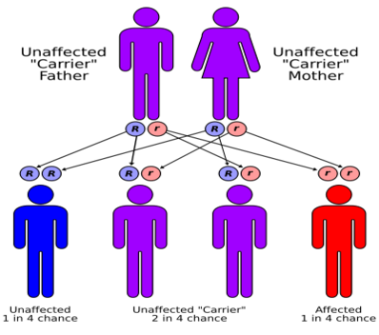
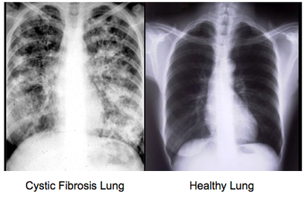
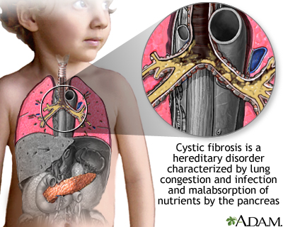
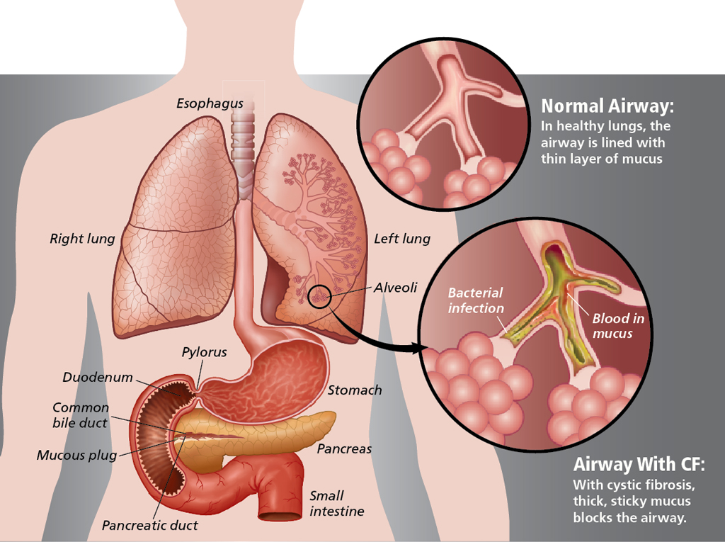
THE END

