Slide 1
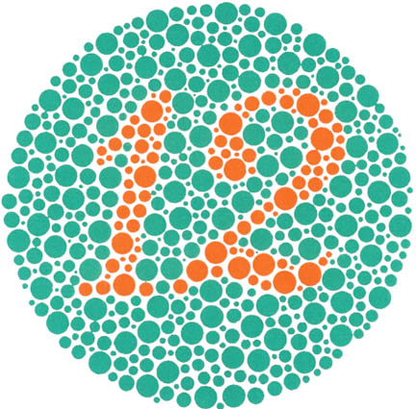
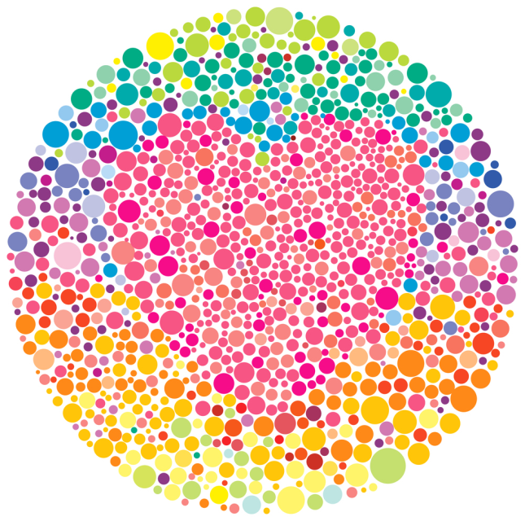
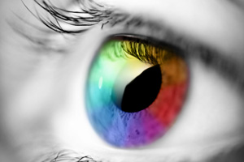
Color blindness
Vyvyan Chau, Esneidy Carranco, Errol Zulueta and Nick Rupert

Slide 2
Color blindness
Color blindness was the chosen name since it affected the losing of one or some of the three color cones in the human eye which are red, green, and blue. It means human diagnosed with color blindness still can see color but is limited to the colors they can see. Some colors could be a total blind or in a different shade from the original.
Alternative names: color vision deficiency, or Daltonism(another name for red/green color blindness). Daltonism was named after John Dolton who discovered color blindness and suffered from red/green color blindness himself.

Slide 3
Colorblindness History
Color blindness was discovered by John Dolton between 1766-1844. He discovered it while suffering from color blindness himself. He started to notice the symptoms of his color blindness as he wore or bought inappropriate colors of clothing for special events. At the age of 26, he bought his mother a pair of stockings as he took mistakenly for it to be blue but in reality it was scarlet. As a devoted Quaker she was expected to not dress soberly (color of wine), because of this incident it caused a miniature scandal in the family. With his experience and further discoveries he wrote the first scientific paper about color blindness called “ Extraordinary facts relating to the vision if colors”.

Slide 4
Types of Colorblindness
Red-Green Color Blindness
The most common type of color blindness is red/green colorblindness, it involves the lost or limited functions of the red cone photo pigments (also called protan) or green cone pigment (also called deutran).
Protanopia- Red cone is blind, meaning red will appear black. Certain shades of orange, yellow, and green all appears as yellow
Protanomaly- Red cone is weak, meaning red, orange, and yellow all appears greener and not as bright.
Deuteranopia- Green cone is blind, meaning no working green cones cells. Red appears as brownish yellow and green appears as beige.
Deuteranomaly- Green cone is weak, meaning yellow and green appears redder and it is difficult to tell violet from blue.

Slide 5
Types of Colorblindness
Blue/yellow Color Blindness
Blue/yellow color blindness is rarer then red/green color blindness. It involves the missing or limited functions of the blue cone photo pigment (also called tritan).
Tritanopia- Blue cone is blind, meaning blue appears greener and yellow appears violet or light grey
Tritanomaly- Blue cone is weak, meaning limited blue cone cells. Blue appears greener and it is difficult to see yellow and red from pink.

Slide 6
Different Color Visions
Deuteranopia- Green cone is blind
Protanopia- Red cone is blind
Deuteranomaly- Green cone is weak
Protanomaly- Red cone is weak
Tritanopia- Blue cone is blind
Tritanomaly- Blue cone is weak

Slide 7
How is Colorblindness Inherited?
The most common type to color blindness to be inherited is the red/green color blindness. Red/green color blindness effect men more than woman since it can only be transfer down by the x chromosome. Since men only have one x chromosome in there body, they will most likely be color blind. However there could be a lot of outcomes due to the different situation each parent can carry. For example fathers can only pass the colorblind gene down to his daughter while the mothers can only pass down the colorblind gene to her son. The following is a list of out comes the son or daughter of a pair could be color blind due to the fact that the parent is a carrier or a diagnosis individual with color blindness.

Slide 8
Inherited Outcomes
1. A colorblind man and a non-colorblind woman No colorblind sons, but all daughters have a 100% chance of being colorblind carriers.
2. A non colorblind man and a colorblind carrier woman
50% chance of sons being colorblind, and 50% chance of daughters being colorblind.
3. A colorblind men and colorblind carrier woman
50% chance of son being colorblind, and 50% chance of daughters being colorblind or a colorblind carrier.
4. A non colorblind man and a colorblind woman
All sons will be colorblind , and all daughters will be color blind gene carrier

Slide 9
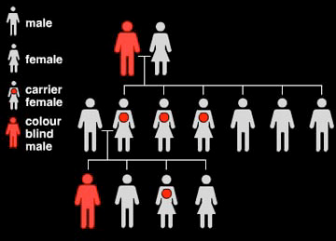
Chromosomes/Genetics

Slide 10
Diagnosis
Doctors can identify that a person is diagnosed with color blindness by using the Ishihara Plate Test. This test only works for red/green color blindness. It contains 38 circular plates covered in irregular colors of dots in two or more colors. The person will be asked what numbers they can see. Some plates contain information in which people with normal vision can see in others contain information only color blind people can see.
Screening test- detect and determines the type and severity of the color blindness

Slide 11
Symptoms
Symptoms of color blindness could range from mild to severe. Examples would be difficult distinguishing between colors, or inability to see shades of the same color. Rapid eye movement could occur in rare causes, and Sensitivity of bright light. They could also suffer from having trouble seeing the brightness of color in the usual way. Inability to tell the differences between shades of the same or similar colors. Particularly red and green or blue and yellow.

Slide 12
Effects of Colorblindness
Effects of color blindness are difficult distinguishing color such as blue and yellow or red and green. Problems can arise in some simple activities such as choosing and preparing food, gardening, sport, driving a car and selecting clothing. Trouble can arise by not being able to pick up a change in someone’s mood or a change in the color of their face, or in some parents cases, notice their child getting sunburn.
Food can look repulsive or unappealing due to the change of the color a colorblind person can see.

Slide 13
Prognosis
Colorblindness does not decrease life expectancy. However, you can get killed in a car crash from reading the traffic lights wrong. The disorder impacts the person who has colorblindness by not allowing the person to tell which color is which. Family members might have to label such colors in order for the person to tell which color the color is.
Color blindness could impact a person by causing troubles in their work and jobs. Problems could arise in fully understanding information on the internet, documents, and on presentations photograph, maps, charts and diagrams.

Slide 14
Treatment/Medications
There are no sudden medications or eye treatments that can help with colorblindness. But there is a company who makes glasses to give colorblind people the ability to see color.
Color filters or contact lenses can be used in some situations to enhance the brightness between some colors. Gene therapy is still in research, but there is also some risk taken from the gene therapy such as some injections to the eye could result in irritation or infection, it could also then lead to complete blindness.

Slide 15
Current research
Colourblindawareness.com is a website that was founded to help raise awareness for colorblindness and they help fund foundations that want to help with colorblindness.

Slide 16
Current research
In the pass year, some current research was done to fine a treatment for color blindness by two researcher from the university of Washington for a possible cure for color blindness. Their research was mostly base on monkeys and a signal shot in the eye that is predicted to reveal the world full of color. The Neitzes focused on this disorder for years on male squirrel monkeys that has inherited red/green color blindness. They will inject chemicals and drugs in their eye such as AVA-322 and AVA-323 (these drugs carry pigment-producing genes) to form what is known as Avalanche. With Avalanche it is injected into the eye vitreous (clear gelatin like liquid that fills the human eye). Once it is injected it will spark the DNA into forming photo pigments revealing colors that most likely is to be seen in normal vision. Right now they are continuing their research on colorblindness as for techniques to correct colorblindness, and using that information on any other related cone-base disorder.

Slide 17
Richard’s life being color blind
An affected individual that been diagnosis with color blindness was Richard. Richard was colorblind when he was born. He had trouble identifying the colors in school. His drawings were in a special palette. Colors to him was very confusing, as red was sometimes gray. He learned to understand traffic lights by sequence and labels colors to tell them apart. At the age of 4 his parents has suspected him with this disorder by misidentifying color blocks of toys, crayons, clothes, and food. Because of this, Richard took the Ishihara test and it had been confirmed he was color blind when he misread all of the classic color plates. Looking from the many small problems he faced it looked like he suffers from red/green color blindness. However he keeps stuff simple such as his wardrobe, he mostly buy lots of blues, gray, and a few greens, he said he most likely like to shop for clothes by texture. Over all it seems as if his life could be as just as normal like everyone else, but one small flaw it he can’t see some of the right colors as everyone else with normal vision could see.

Slide 18
Source Cited
1.None, Richard None. "Richard's Life as a Color Blind." Colblindor. None Listed, 08 Feb. 2010. Web. 31 Mar. 2016.
2.Institute, Natural Eye. "Facts About Color Blindness." Facts About Color Blindness. National Eye Institute, ?? Feb. 2015. Web. 31 Mar. 2016.
3.On Page, None Listed. "Treatment." Color Blind Awareness. Genevolve, ?? Web. 31 Mar. 2016.

Slide 19
Source Cited
4.Lauren, Hillary None. "Color Blindness Interview." The Science Slug. Science Slug, 26 Aug. 2014. Web. 31 Mar. 2016.
5.Levine, Karen None. "50 Facts about Color Blindness | Colblindor." Colblindor. Colblindor, 6 Jan. 2009. Web. 31 Mar. 2016.
6.Ding, Chien Kuang. "Disorders." Disorders. Durant Road Middle School, Raleigh. 23 Feb. 2016. Lecture.

