Slide 1
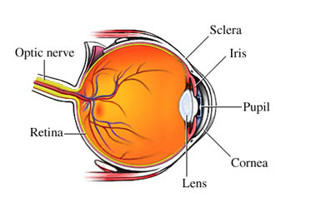
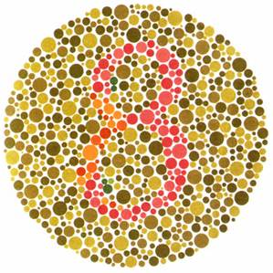
COLOR BLINDNESS
By: Haley Stroud, Conor Presto, Ethan Davis, Kayla Hall, , and Dante McGuire

Slide 2
Color Blindness
Also known as color vision deficiency, Daltonism,and Poor color vision.
The name Color Blindness was chosen because people with this condition can’t distinguish certain shades of color making them “blind” to color.
This name is actually misleading because very few people are actually colorblind. This is why color vision deficiency describes it better.
In 1794 at the Department of Molecular Genetics, University of London John Dalton described his own Color Blindness. Both John Dalton and his brother confused red with green and pink with blue. Dalton supposed that his vitreous humor was blue but they were perfectly clear. Dalton was a deuteranope and lacked the middle wave photopigment of the retina.

Slide 3
Type of genetic disorder
Color Blindness is the inability to distinguish the difference between some colors. It is the result of an absence of color sensitive pigment in the cone cells of the retina.
Color Blindness is passed down on the X chromosome. Chromosomes contain genes which have the instructions for the development of cells tissues, and organs. If you are colorblind it means the instructions for the development of your cone cells are faulty. This means they can be missing, less sensitive to light, or the pathway from your cone cells to your brain may not be developed

Slide 4
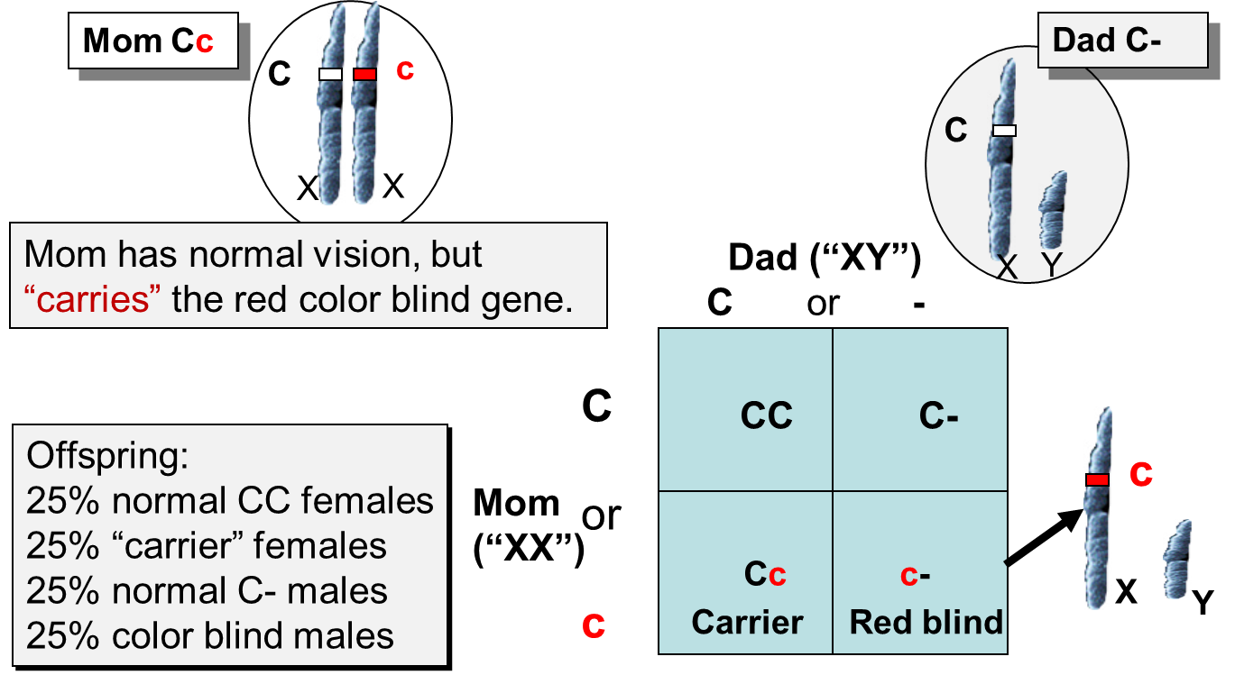
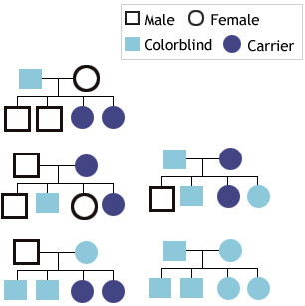
Color Blind Chromosome Graphic

Slide 5
Symptoms of Color Blindness Part 1
The person may not be able to differentiate red and green colors, or the blue and yellow colors
Sometimes, in less severe cases, the person is simply not able to see or distinguish the shades of any color
People who suffer from total color blindness may not be able to see any colors except for black, white and gray
Not being able to see the brightness of colors is also an important color blindness symptom

Slide 6
Symptoms of Color Blindness Part 2
There are 3 types of color blindness, Protanomaly, Deuteranomaly, and tritanomaly.
Protanomaly is reduced sensitivity to red light
Deuteranomaly is reduced sensitivity to green light and is the most common.
Tritanomaly is reduced sensitivity to blue light which is the rarest form.

Slide 7
Symptoms of Color Blindness Part 3
People with Protanomaly confuse: black with red, dark brown with dark green, dark orange with dark red, blues with reds, purple with dark pinks, mid-green with oranges.
People who have Deuteranomaly confuse: mid-red with mid-green, blue-green with gray, pale pinks with dark grey, mid-reds with mid-green, and light-blue with lilac
People who have tritanomaly confuse: blue with grey, purple with black, green with blue, and orange with red.
COMPETITION what competition lol lol lol
meme lord potato nudes

Slide 8
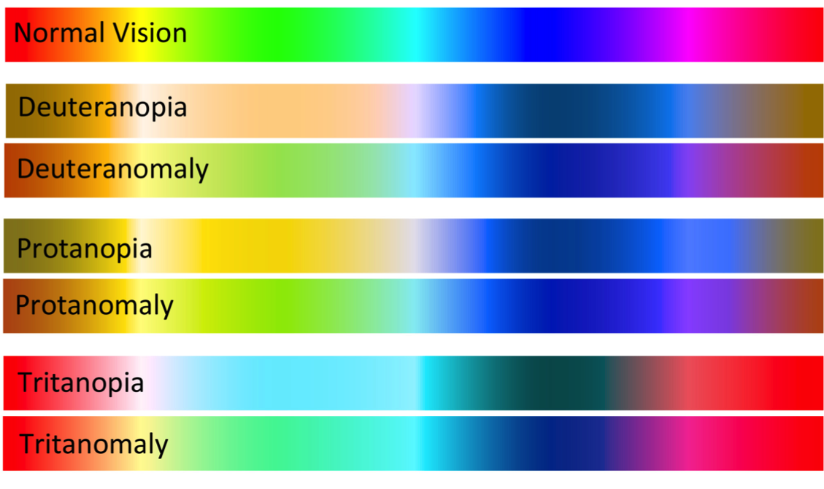
Effects of the Disorder
You will not be able to see some colors
Other colors will appear a different color
You cannot tell the difference between some foods/sauces/ingredients
Harder to drive
Extremely hard for primary students because of the color teachings
Color blind people can see colors, but some colors fade into black and white or different colors
If you have a 36 pack of colored pencils you could only see 12 of them

Slide 9
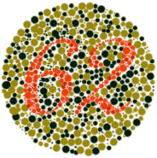
Diagnosis of Disorder
Color-blindness can be difficult to detect
Some children don’t believe they have problems with color vision
Eye doctors (Optometrists) should check you on routine for color issues
Most common test is the Ishihara Plate Test
More sophisticated tests like the Lantern Test see if colorblind people can still apply for certain jobs where you need to accurately be able to identify colors (ex: train drivers, marine, or aviation jobs).

Slide 10
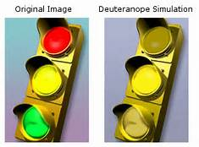
Color Blindness Impact Part 1
Does not impact life expectancy directly.
EX: A person that is color blind is expected to live a normal length life, but if they cannot tell which color is which at a stop light they can be killed in a crash.
Limited: Can’t tell difference between some colors.
Most commonly inherited is Deuteranopia (red & green) where they can’t tell the difference between red & green.
Can impact you physically.
Can affect certain jobs you can have.
EX: Piloting an airplane.

Slide 11
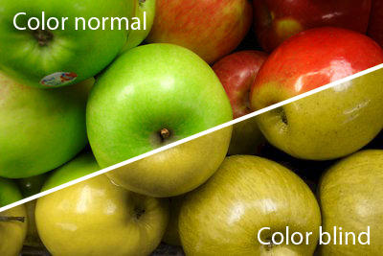
Colorblindness impact Part 2
Can impact health by not telling if food is good or not
Can impact family mentally if a family member with it was injured due to accidents.
Might have family members constantly help them.

Slide 12
Color Blind Treatments
No current medical treatment has been created to cure the disorder or symptoms of the disorder
Some color filters and contact lenses, however, have been created to give people with the disorder normal vision
These lenses and filters also have side effects, like further confusion
No treatments have been used in any time period
Gene therapy is a possibility that scientists are currently looking forward to in the future

Slide 13
The PHG Foundation
The PHG Foundation works to fight against diseases like color blindness.
The PHG Foundation has been able to cure red-green color blindness in adult monkeys.
They believe that that being able to cure color blindness in monkeys could carry over to humans and help find a cure to stop color blindness.

Slide 14
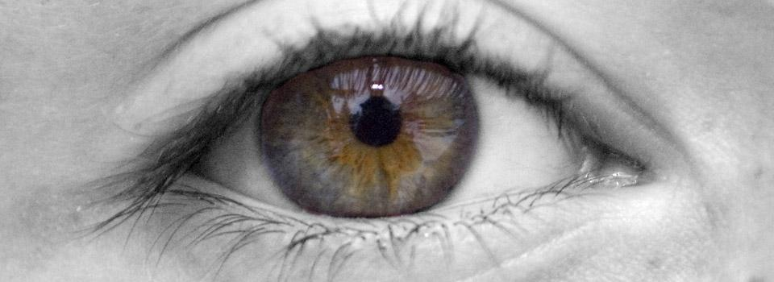
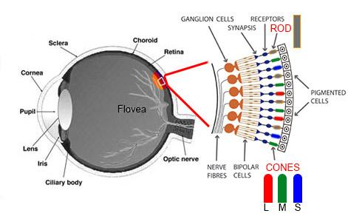
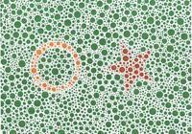
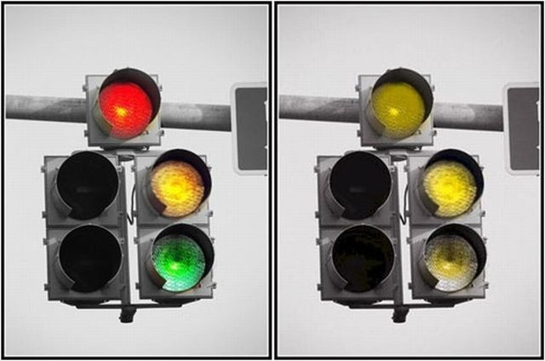
Color Blindness Graphic
http://www.youtube.com/watch?v=gRfJz9boH10

Slide 15
Peter Milton
Peter Milton is a 32 year old Art teacher at the Maryland Institute College of Art in Baltimore and a painter, when he was diagnosed with Deuteranopia (red-green colorblindness). Milton then abandoned color and embraced black and white in his paintings, and focused more on detail, rather than color. He claims that he doesn’t miss color and that differences in vision are of no importance.
One of Milton’s artworks-

Slide 16
Works Cited
Evancie, Angela. "For One Artist, Colorblindness Opened Up A World Of Black And White." Npr. Vermont Public Radio, 14 Nov. 2014. Web. 5 Apr. 2016.
Lusby, Franklin W., MD Ophthalmologist. "Color Blindness." Medline Plus. Lusby Vision Institute, 5 Nov. 2015. Web. 4 Apr. 2016.
Hunt, DM, Dulai, KS, Bowmaker, JK, and Mollon, JD. "The Chemistry of John Dalton's Color Blindness." The Chemistry of John Dalton's Color Blindness. - PubMed - NCBI. Department of Molecular Genetics, University of London, UK, 17 Feb. 1995. Web. 4 Apr. 2016.
Pruthi, Sandhya, MD. "Poor Color Vision." Mayo Clinic. Mayo Clinic, 13 Feb. 2014. Web. 4 Apr. 2016.
Colblindor. “Terminology of Color Blindness.” Colblindor. WordPress, 9 Feb. 2007. Web. 4 Apr. 2016.

