Slide 1
Balanced and Unbalanced Forces
How do balanced and unbalanced forces affect an object's motion?

Slide 2
What is inertia?
Inertia is the resistance of any physical object to any change in its state of motion, including changes to its speed and direction.
Inertia tells us the we need a force to get an object to move or stop an object from moving.
Notes:
Before continuing, play the Study Jams video on inertia.

Slide 3
What is a force?
•In science, a force is a push or a pull.
•All forces have two properties:
Direction and Size
•A newton (N) is the unit that describes the size of a force.

Slide 4
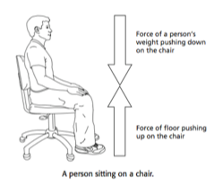
What is a force
•The student is pushing down on the chair, but the chair does not move.
•The floor is balancing the force by pushing on the chair.

Slide 5
Combining Forces
•More than one force often acts on an object.
•When all the forces acting on an object are added together, you determine the net force on the object.
•An object with a net force more than 0 N on it will change its state of motion.
Notes:
Have students brainstorm a list of the different forces that could act on an object. Draw a box on the board with arrows pointing in the direction of each force.

Slide 6
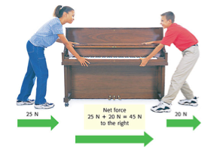
Forces in the Same Direction
•When forces are applied in the same direction, they are added to determine the size of the net force.

Slide 7
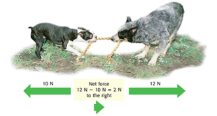
Forces in Different Directions
•When two forces act in opposite directions, you subtract the smaller force from the larger force to determine the net force.
•The net force will be in the same direction as the larger force.

Slide 8
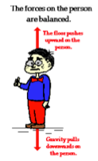
Balanced Forces
•When the forces on an object produce a net force of 0 N, the forces are balanced.
•There is no change in the motion of the object.

Slide 9
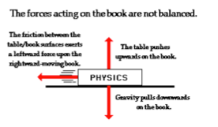
Unbalanced Forces
•When the net force on an object is not 0 N, the forces on the object are unbalanced.
•Unbalanced forces produce a change in motion of an object.

Slide 10
Let’s Practice!
350 N
Net Force ____________
ç
Notes:
Answer: 350 N ---->

Slide 11
Let’s Practice
200 N
Net Force: _______________
Notes:
Answer: 200 N ^

Slide 12
Let’s Practice
75 N
150 N
75 N
Net Force _________________
Notes:
Answer: 0 N

Slide 13
Let’s Practice
10 N
30 N
10 N
Net Force: __________
Notes:
Answer: 30 N ←-

Slide 14
Exploring Forces
We will look at three examples of forces:
Friction
Gravity
Magnets

Slide 15
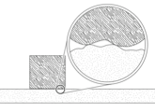
Friction
•Friction is the force that opposes the motion between two surfaces that touch.
•The surface of any object is rough.
•Even an object that feels smooth is covered with tiny hills and valleys.
•The contact between the hills of valleys of two surfaces causes them to stick, resulting in friction.

Slide 16
Friction
•The amount of friction depends on:
–Roughness of the surfaces
–Force pushing the surfaces together

Slide 17
Types of Friction
Kinetic friction occurs when force is applied to an object and the object moves.
Examples:
Sliding Friction: pushing an object across a surface
Rolling Friction: between wheels and a surface
Fluid Friction: opposes the motion of objects traveling through a fluid (air or water)

Slide 18
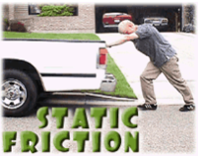
Types of Friction
Static friction occurs when force applied to an object does not cause the object to move.

Slide 19
Reducing Friction
•To reduce the amount of friction, apply a lubricant between two surfaces.
Ex) Motor oil, wax, and grease
•Friction can also be reduced by rolling, rather than pushing, an object.
Notes:
Before you show ways to reduce friction, ask students to talk to a partner and brainstorm ways to reduce friction. If you have your desks in groups, you can say turn to your shoulder partner or talk to your face partner!

Slide 20
Increasing Friction
Friction increases when the surface area of an object increases.
Friction increases as surfaces are made rougher.
Friction increases when the force between two objects increases.
Notes:
Before you show ways to increase friction, ask students to talk to a different partner and brainstorm ways to increase friction.

Slide 21
Discuss!
How does friction affect an object’s movement?
How can friction be beneficial?
How can friction be a problem?
Which stations demonstrated friction at work?
Notes:
Kagan’s All-Write-Round-Robin- Student’s will be in small groups. Students will rotate through their group. Each student will share out one idea at a time. All students will write their peers responses. One person from each group will stand up and the teacher will go around the room compiling a list. When each item that is on each student’s list has been shared, they may take a seat.

Slide 22
Gravity
Gravity is the force of attraction between matter.
Gravity depends on:
mass and distance
Notes:
Before starting the section on gravity, play the Brainpop video on gravity.

Slide 23
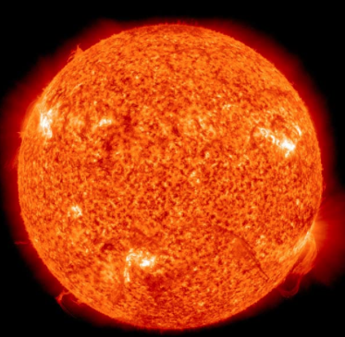
Mass and Gravity
The more massive an object the more it can attract objects to itself.
For example, the Sun has a larger gravitational effect than the Earth.

Slide 24
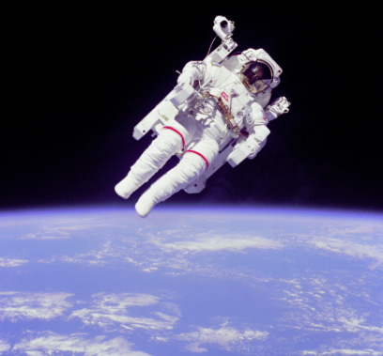
Distance and Gravity
The further away objects get from one another, the less gravitational attraction can be found.

Slide 25
Discuss!
How does gravity affect an object’s motion?
Is gravity balanced, unbalanced, or both? Give evidence to support your answer.
Was gravity at play in any of the stations?

Slide 26
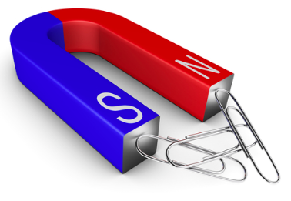
Magnets
A magnet is an object with a north and south pole that produces a magnetic field and exerts a magnetic force.
Notes:
Before beginning magnets, play the Brainpop video on magnetism.

Slide 27
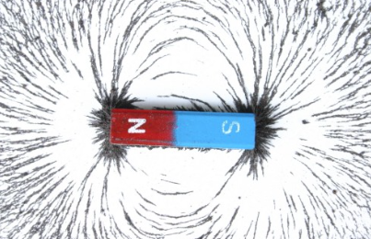
Magnets
A magnetic field is the force field that surrounds the magnet.
A magnetic force can cause objects to attract or repel without needing to touch the magnet!

Slide 28
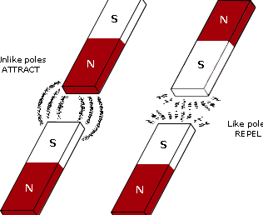
Poles
Like poles will repel or move away from one another.
Opposite poles will attract or move towards one another.

Slide 29
Compass
A compass uses the Earth’s magnetic field and magnets to help a person determine direction. The magnet’s poles will line up with the Earth’s north magnetic pole and south magnetic pole.

Slide 30
Discuss!
How do magnets affect an object’s motion?
What happens to an object's motion if no forces are acting on it?

